Slide 1
RISC PROCESSOR DESIGN ON FPGA
Istanbul Technical University
Computer Engineering Department
Graduation Project
Tuğrul YATAĞAN 040100117
Advisor: Assoc. Prof. Dr. Mustafa Ersel Kamaşak

Slide 2
Outline
Introduction
Processor properties
Processor organization
Instruction set architecture
Processor pipeline
Pipeline hazards & solutions
Assembler
FPGA implementation
Performance

Slide 3
Introduction
In this Project;
A 16-Bit RISC soft processor is designed, simulated and implemented on Xilinx FPGA with Verilog hardware description language.
An assembler is developed for soft processor with Python.
Advisor: Assoc. Prof. Dr. Mustafa Ersel Kamaşak
Former Advisor: Prof. Dr. Ahmet Coşkun Sönmez

Slide 4
Properties
RISC architecture
Mixture of THUMB and MIPS commercial architectures
Harvard architecture so it has separate instruction and data memory
Fixed length Load/Store instruction set architecture which means only load and store instructions can access to data memory
Single cycle instruction execution capability, easier pipeline design

Slide 5
Organization - 1
16 Bit CPU, ALU, register and data bus architecture
Address bus for data and instruction memory is 12 bit so maximum addressable instruction and data memory is 4K word and it is equal to 8KB
8 general purpose 16 bit registers in register file
16 bit instruction and condition code register
12 bit program counter and address register
All general purpose registers are accessible
PC can only be modifiable via branch instructions, its content is not accessible
IR content is not accessible

Slide 6
Organization - 2
Condition code register
Registers
Bit | Equivalent
N | Negative/Less than
Z | Zero
C | Carry/Borrow
V | Overflow
IEN | Interrupt Enable
IRQ | Interrupt Request
Abbreviation | Equivalent | Bit
R0 | General purpose register 0 | 16
R1 | General purpose register 1 | 16
R2 | General purpose register 2 | 16
R3 | General purpose register 3 | 16
R4 | General purpose register 4 | 16
R5 | General purpose register 5 | 16
R6 | General purpose register 6 | 16
R7 | General purpose register 7 | 16
IR | Instruction register | 16
PC | Program counter | 12
AR | Address register | 12
CCR | Condition code register | 16

Slide 7
Instruction Set Format
Abbreviation | Equivalent | Bit
Rd | Destination Register | 3
Rs | Source Register | 3
Rb | Base Register | 3
Ro | Offset Register | 3
Off# | Immediate Offset | #
Op | Operation | X
Cond | Condition | X
All instructions are16 Bit fixed length instruction.
There are 11 type of instruction.
Load/Store instruction set architecture, so only load and store instructions can access to data memory.
Instruction Types
Inherent Instructions
Shift Instructions
Add/Subtract Register Immediate Instructions
Move/Compare/Add/Subtract Immediate Instructions
ALU Instructions
Load/Store with Register Offset Instructions
Load/Store with Immediate Offset Instructions
Conditional Branch Instructions
Unconditional Branch Instruction
Branch to Subroutine Instruction
Move Long Immediate

Slide 8
Instruction Set - 1
Inherent
Shift
Add/Subtract Register Immediate
Move/Compare/Add/Subtract Immediate
ALU
Assembly | Action | Updates
NOP | No operation
ION | Interrupts on | I
IOF | Interrupts off | I
RTI | Return from interrupt
RTS | Return from subroutine
LSL Rd, Rs, #Off4 | Logic shift left by #Off4 | N Z C
LSR Rd, Rs, #Off4 | Logic shift right by #Off4 | N Z C
ASR Rd, Rs, #Off4 | Arithmetic shift right by #Off4 | N Z C
CSL Rd, Rs, #Off4 | Circular shift left by #Off4 | N Z C
ADD Rd, Rs, #Off6 | Rd := Rs + #Off6 | N Z C V
SUB Rd, Rs, #Off6 | Rd := Rs - #Off6 | N Z C V
MOV Rd, #Off8 | Rd := #Off8 | N Z
CMP Rd, #Off8 | Rd - #Off8 | N Z C V
ADD Rd, #Off8 | Rd := Rd + #Off8 | N Z C V
SUB Rd, #Off8 | Rd := Rd - #Off8 | N Z C V
AND Rd, Rs, Rn | Rd := Rs AND Rn | N Z
OR Rd, Rs, Rn | Rd := Rs OR Rn | N Z
XOR Rd, Rs, Rn | Rd := Rs XOR Rn | N Z
LSL Rd, Rs, Rn | Rd := Rs << Rn | N Z C
LSR Rd, Rs, Rn | Rd := Rs >> Rn | N Z C
ASR Rd, Rs, Rn | Rd := Rs ASR Rn | N Z C
CSL Rd, Rs, Rn | Rd := Rs CSL Rn | N Z C
ADD Rd, Rs, Rn | Rd := Rs + Rn | N Z C V
SUB Rd, Rs, Rn | Rd := Rs – Rn | N Z C V
NEG Rd, Rs | Rd := -Rs | N Z
NOT Rd, Rs | Rd := NOT Rs | N Z
CMP Rs, Rn | Rs – Rn | N Z C V
TST Rs, Rn | Rs AND Rn | N Z C V

Slide 9
Instruction Set - 2
Assembly | Action
LD Rd, [Rb, Ro] | Rd := MEM[Rb + Ro]
LD Rd, [Rb, #Off6] | Rd := MEM[Rb + #Off6]
STR [Rb, #Off6], Rd | MEM[Rb + #Off6] := Rd
BTS #Off11 | Branch to subroutine
BAL #Off11 | Branch always
BEQ #Off9 | Branch if equal
BNE #Off9 | Branch if not equal
BCS #Off9 | Branch if unsigned higher or same
BCC #Off9 | Branch if unsigned lower
BMI #Off9 | Branch if negative
BPL #Off9 | Branch if positive or zero
BVS #Off9 | Branch if overflow
BVC #Off9 | Branch if no overflow
BHI #Off9 | Branch if unsigned higher
BLS #Off9 | Branch if unsigned lower or same
BGE #Off9 | Branch if signed greater than or equal
BLT #Off9 | Branch if signed less than
BGT #Off9 | Branch if signed greater than
BLE #Off9 | Branch if signed less than or equal
Load/Store with Register Offset
Load/Store with Immediate Offset
Conditional Branch
Unconditional Branch
Branch to Subroutine
Move Long Immediate

Slide 10
Example Instructions
Inherent
NOP
Shift
LSR R2, R5, #10
Add/Subtract Register Immediate
ADD R1, R4, #60
Move/Compare/Add/Subtract Immediate
MOV R1, #130
ALU
XOR R2, R5, R3
Load/Store with Register Offset
LD R3, [R5, R2]
Load/Store with Immediate Offset
STR [R5, #26], R1
Conditional Branch
BEQ Label
Unconditional Branch
BAL Label
Subroutine
BTS Label

Slide 11
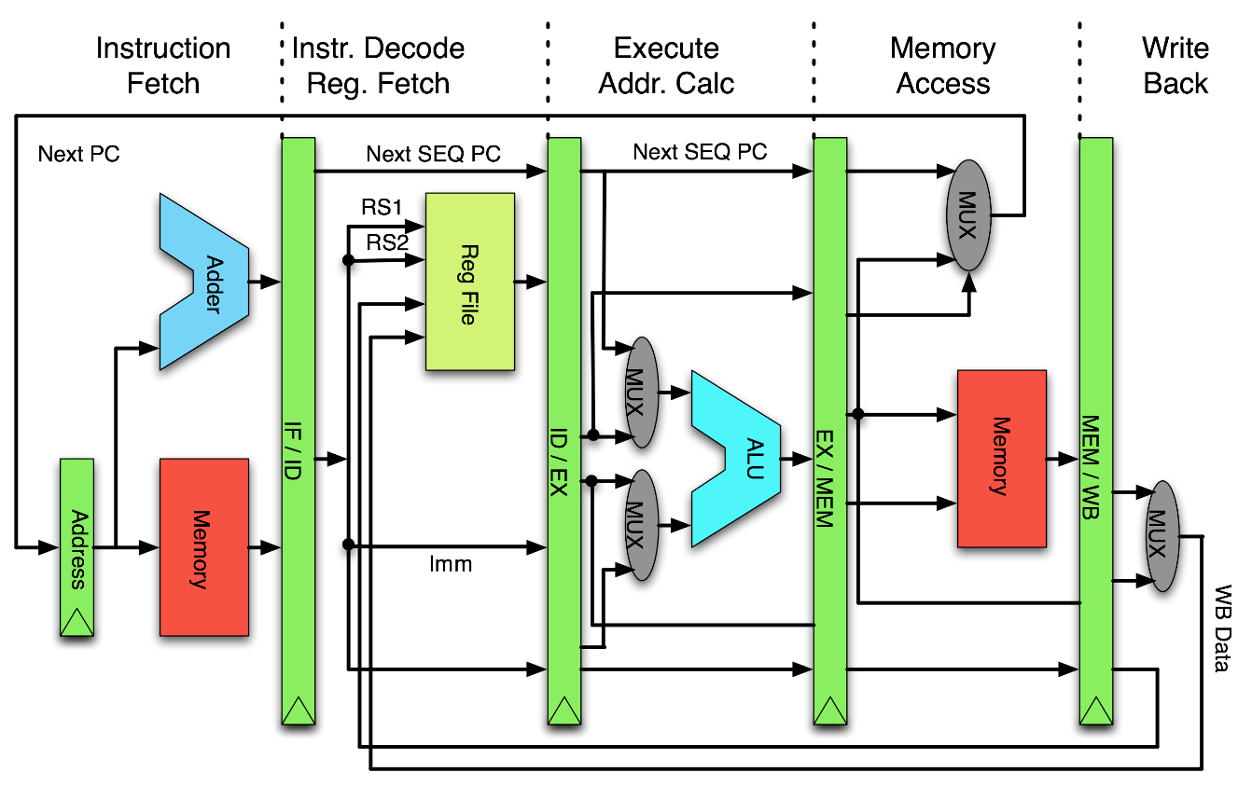
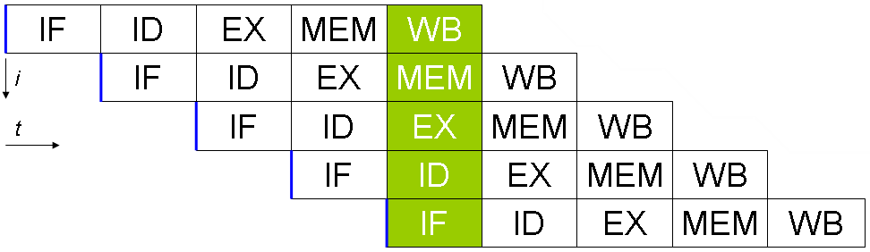
Pipeline
Classic RISC 5 stages pipeline architecture
Instruction fetch
Instruction decode
Execute (ALU)
Memory access
Write back
RISC pipeline organization [10]
5 stage classic RISC pipeline timing diagram [10]

Slide 12
Pipeline Hazards
Data hazards occurs if;
Register type operand needs to be read but previous instruction is not finished
Memory type instruction result need to be read by following register type instruction.
Control hazards occurs if;
Branch is taken
Subroutine call
Interrupt
Solutions;
Data forwarding
Pipeline stall
Pipeline flush

Slide 13
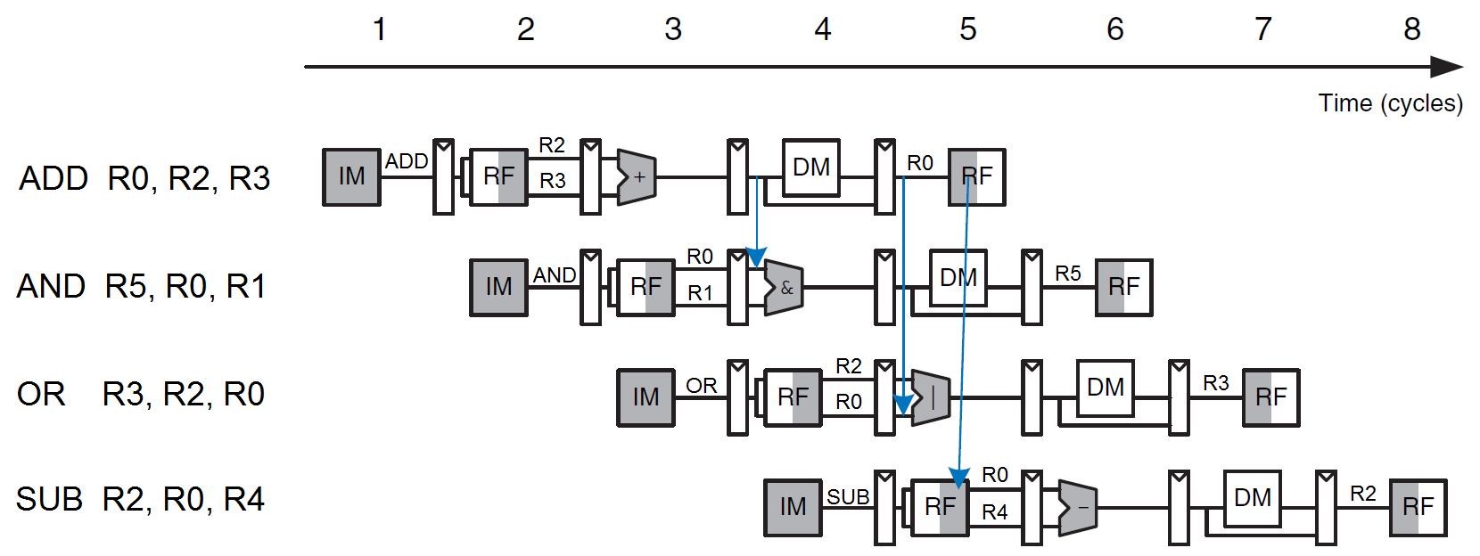
Pipeline Hazard Solutions: Data Forwarding
Data forwarding solves register operand data hazards.
Data forwarding timing diagram [3]

Slide 14
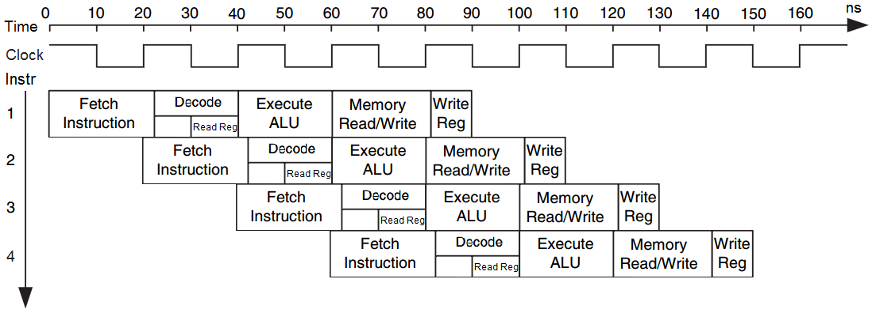
Pipeline Timing
Decode, register read and register write operations are done in same clock cycle.
Timing diagram of pipeline stages [3]

Slide 15
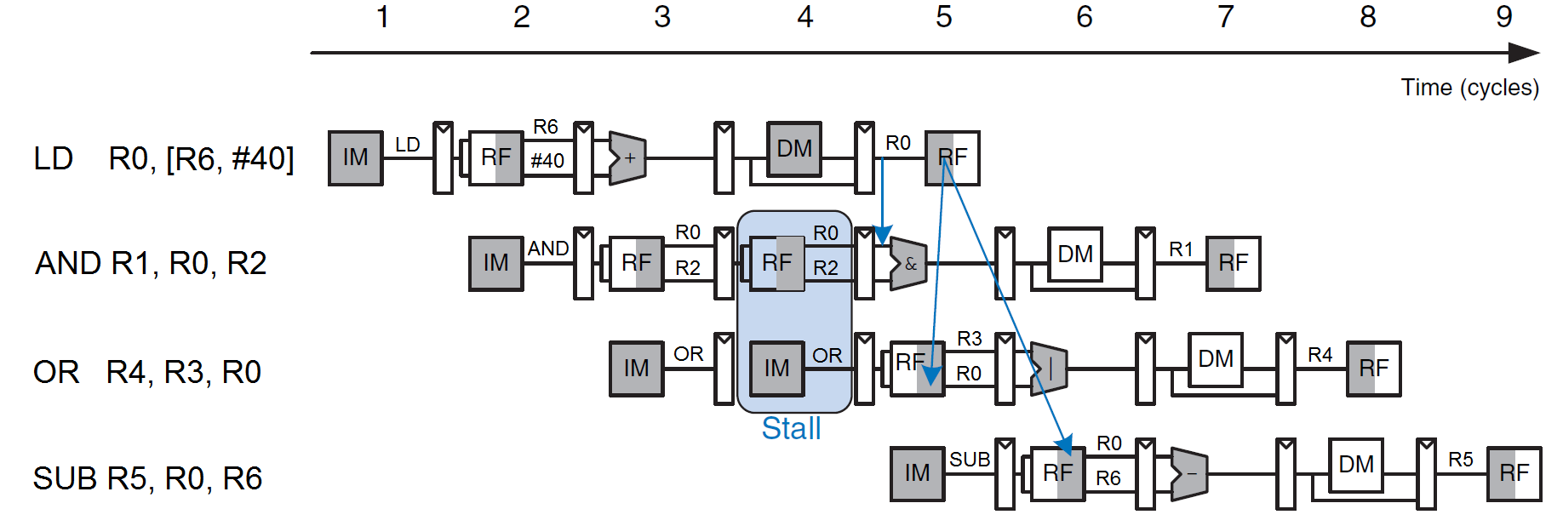
Pipeline Hazard Solutions: Pipeline Stall
Pipeline stall operation solves memory type data hazard but solution has a one clock cycle pipeline penalty
Pipeline stall timing diagram [3]

Slide 16
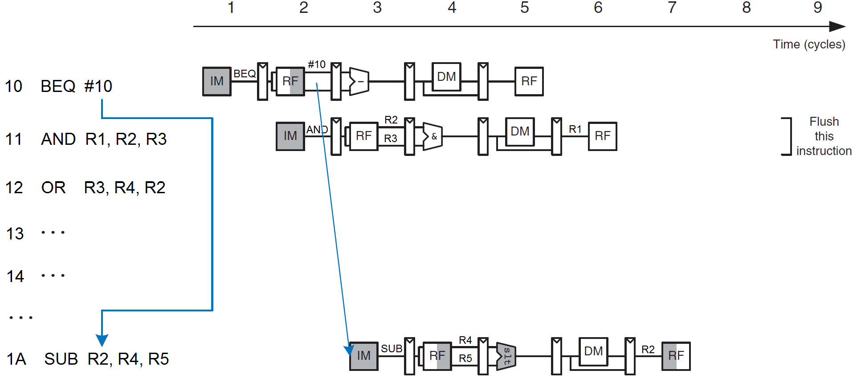
Pipeline Hazard Solutions: Pipeline Flush
Pipeline flush solves branch hazards but solution has a one clock cycle pipeline penalty
Pipeline stall timing diagram[3]

Slide 17
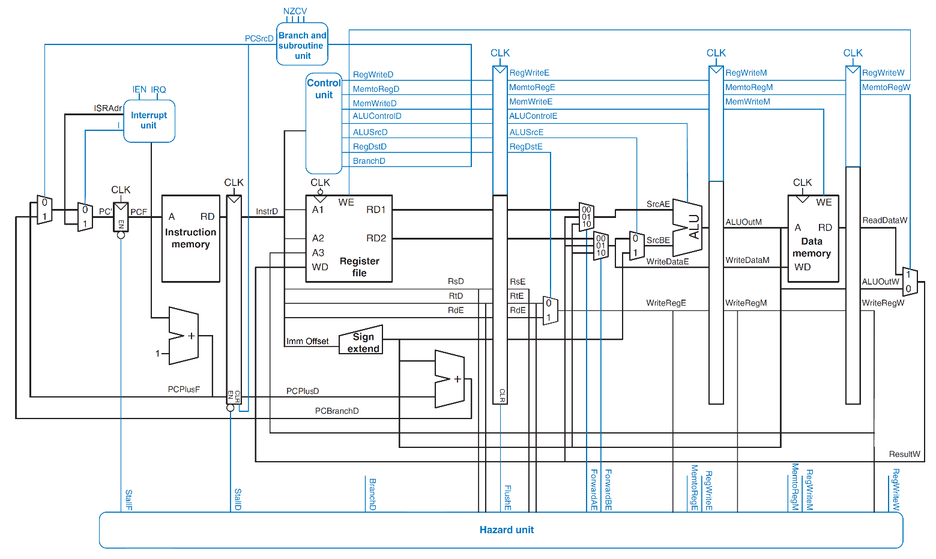
Structure of the Processor
Processor organization schematic with control and hazard units [3]

Slide 18
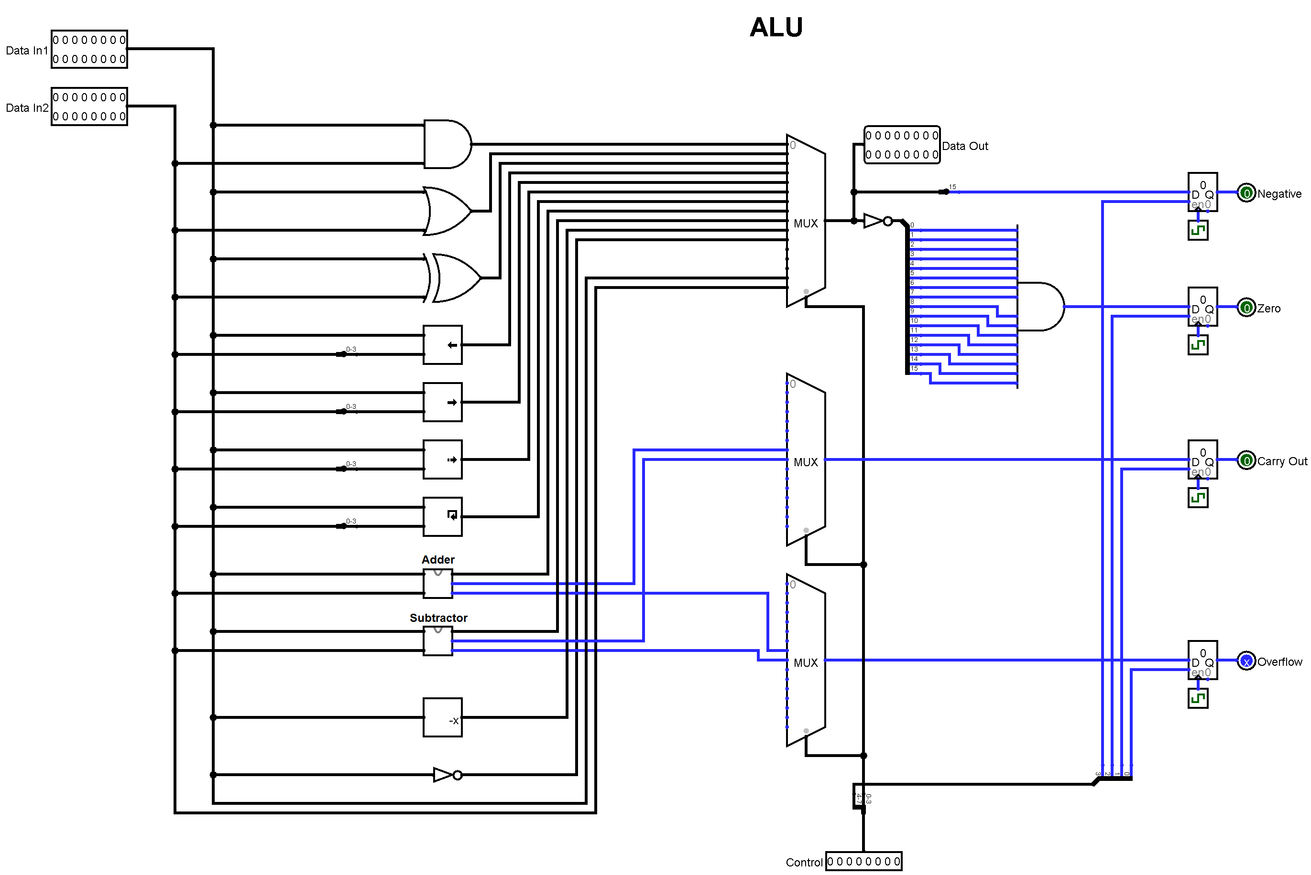
ALU
Logical AND
Logical OR
Logical XOR
Logical left shift
Logical right shift
Arithmetic shift right
Circular shift left
Arithmetic add
Arithmetic subtract
Arithmetic negation
Logical NOT

Slide 19
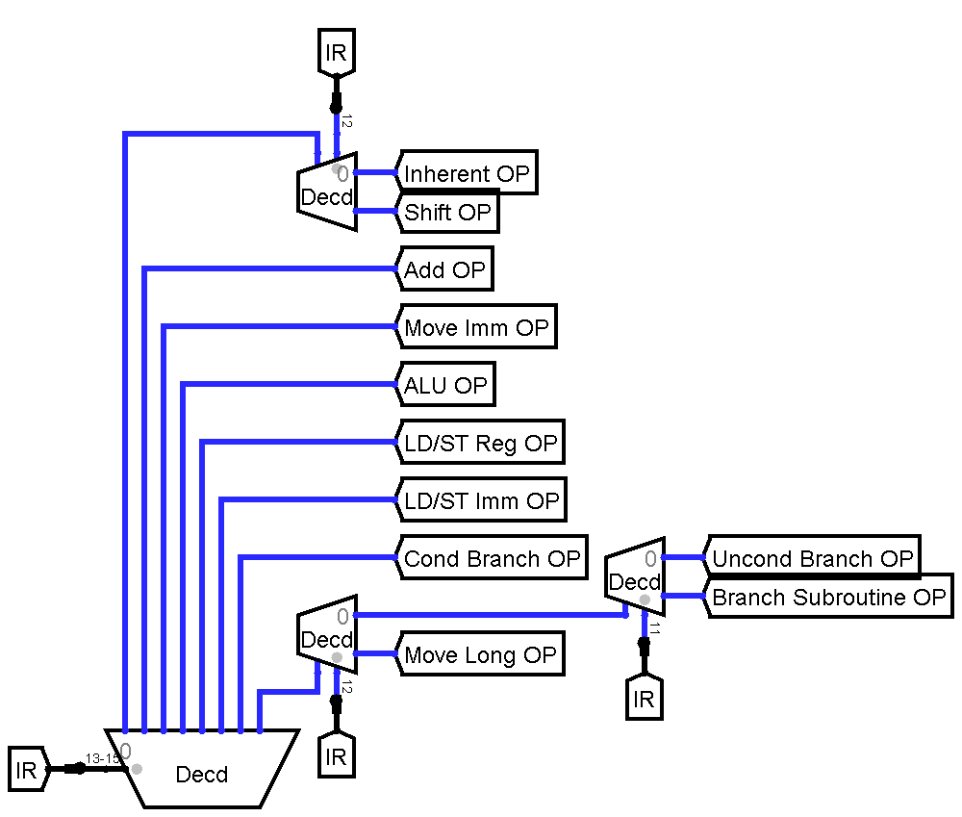
Decode
Inherent Instructions
Shift Instructions
Add/Subtract Register Immediate Instructions
Move/Compare/Add/Subtract Immediate Instructions
ALU Instructions
Load/Store with Register Offset Instructions
Load/Store with Immediate Offset Instructions
Conditional Branch Instructions
Unconditional Branch Instruction
Branch to Subroutine Instruction
Move Long Immediate

Slide 20
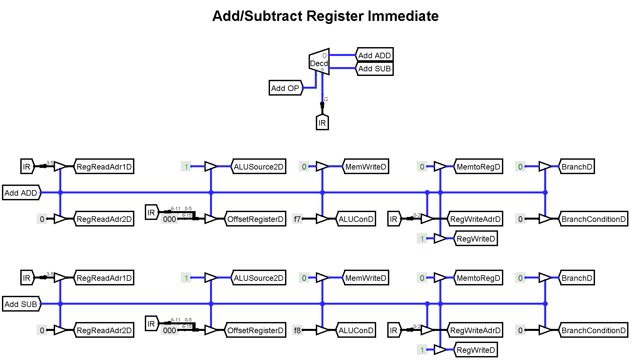
Decode Example
Verilog
Logisim
4'b001x: begin
reg_read_adr1_d = IR[5:3];
reg_read_adr2_d = 3'h0;
reg_write_adr_d = IR[2:0];
reg_write_d = 1;
ALU_source2_d = 1;
offset_register_d = {10'h000, IR[11:6]};
mem_write_d = 0;
mem_to_reg_d = 0;
branch_d = 0;
branch_condition_d = 4'h0;
IEN_d = 0;
IOF_d = 0;
RTI_d = 0;
subroutine_call_d = 0;
subroutine_return_d = 0;
case (IR[12])
0: ALU_con_d = 8'hf7;
1: ALU_con_d = 8'hf8;
endcase
end

Slide 21
Assembler
A Python script is written for assemble instructions and create binary machine instructions.
Assembler uses simple regular expressions to parse instruction mnemonics.
After generating instruction binaries, these are converted to Logisim memory input file format, ISim memory input file format and Xilinx FPGA mem input file format.
Assembler has some special words for create predefined variables.
Assembler variables can resides between “_initial” and “_end” block.
“ $ ” character assigns decimal variable.
“ & ” character gives starting address of variable.
“ ; ”character makes afterwards a comment in a line.

Slide 22
Example Assembly Program
Assembler input:
C equivalent:
; I/O test
_initial
$proc_in = 4080
$proc_out = 4081
_end
MOV R2, #4
MOV R3, #3
H: CSL R3, R3, #1
SUB R2, R2, #1
BNE H
ADD R1, R1, #1
MOVL R0, $proc_out
STR [R0], R3
F: BAL F
int a = 3;
for (int i = 4; i > 0; i--)
a = a << 1;
Assembler output:
010 0100001000000100 4204 MOV R2 #4
011 0100001100000011 4303 MOV R3 #3
012 0001110001011011 1C5B CSL R3 R3 #1
013 0011000001010010 3052 SUB R2 R2 #1
014 1100001111111101 C3FD BNE H
015 0010000001001001 2049 ADD R1 R1 #1
016 1111111111110001 FFF1 MOVL R0 #4081
017 1011000000000011 B003 STR [R0] R3
018 1110011111111111 E7FF BAL F

Slide 23
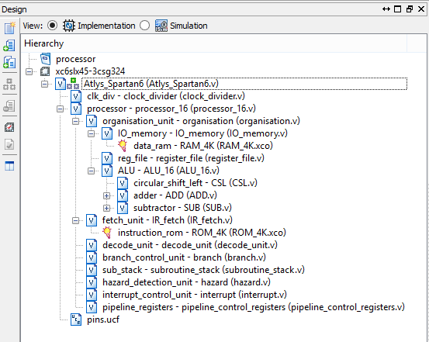
Processor Verilog Modules
Processor [ processor ]
Organization unit [ organization_unit ]
I/O and data memory unit [ IO_memory ]
Register file [ register_file ]
ALU [ ALU ]
Fetch unit [ fetch_unit ]
Instruction memory [ instruction_rom ]
Decode unit [ decode_unit ]
Branch control unit [ branch_control_unit ]
Subroutine stack [ subroutine_stack ]
Hazard detection unit [ hazard_detection_unit ]
Interrupt control unit [ interrupt_control_unit ]
Pipeline control registers [ pipeline_registers ]

Slide 24
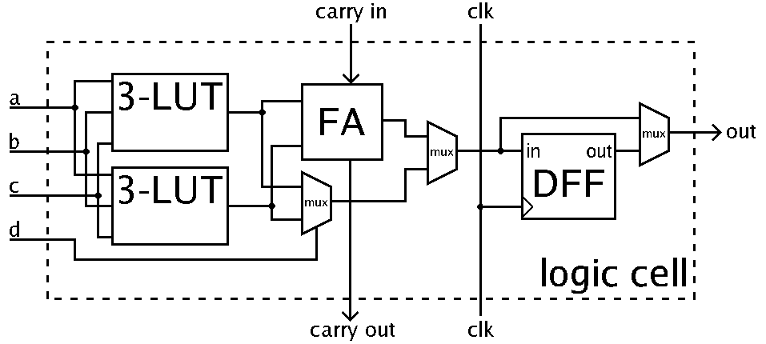
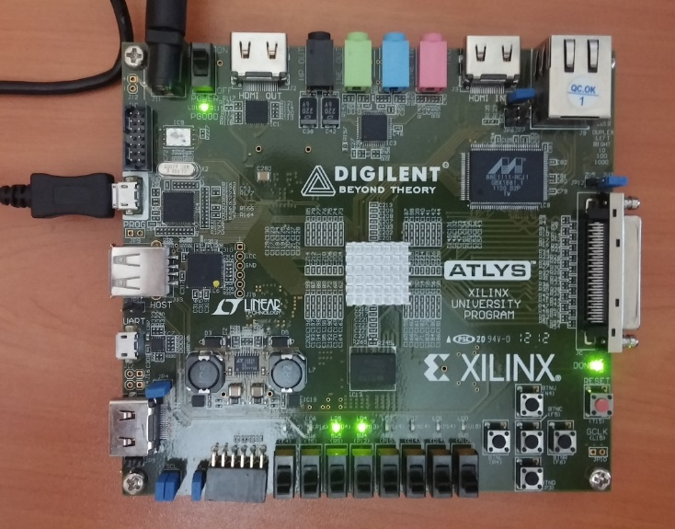
FPGA Implementation
Xilinx Spartan-6 XC6SLX45 FPGA [1]
6,822 slices, each containing four 6-input LUTs and eight flip-flops
2,088 Kb block ram capacity
50MHz clock frequency
FPGA logic cell illustration [6]
Xilinx ISE synthesis place and route report:
Device Utilization Summary:
Slice Logic Utilization:
Number of Slice Registers: 415 out of 54,576 1%
Number of Slice LUTs: 623 out of 27,288 2%
Number used as logic: 579 out of 27,288 2%
Number used as Memory: 25 out of 6,408 1%

Slide 25
Demo Assembly Program
Assembler input:
C equivalent:
; I/O test
_initial
$proc_in = 4080
$proc_out = 4081
_end
MOV R2, #4
MOV R3, #3
H: CSL R3, R3, #1
SUB R2, R2, #1
BNE H
ADD R1, R1, #1
MOVL R0, $proc_out
STR [R0], R3
F: BAL F
int a = 3;
for (int i = 4; i > 0; i--)
a = a << 1;
Assembler output:
010 0100001000000100 4204 MOV R2 #4
011 0100001100000011 4303 MOV R3 #3
012 0001110001011011 1C5B CSL R3 R3 #1
013 0011000001010010 3052 SUB R2 R2 #1
014 1100001111111101 C3FD BNE H
015 0010000001001001 2049 ADD R1 R1 #1
016 1111111111110001 FFF1 MOVL R0 #4081
017 1011000000000011 B003 STR [R0] R3
018 1110011111111111 E7FF BAL F

Slide 26
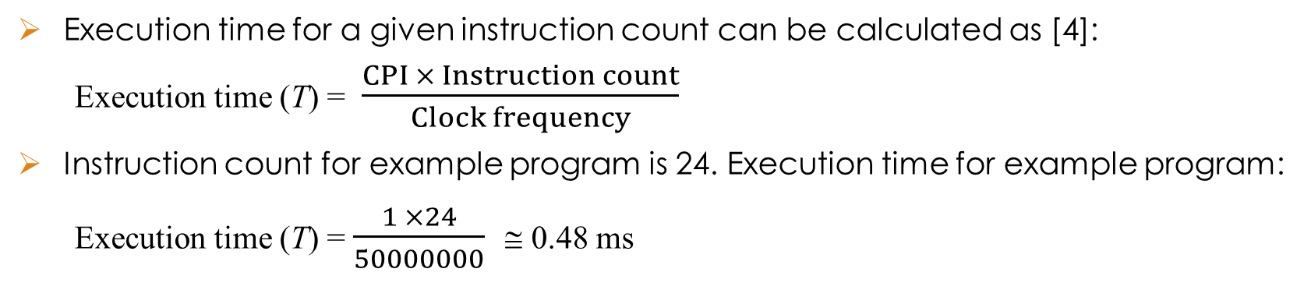
Performance
With the help of pipeline, processor can achieve instruction level parallelism.
Nominal cycles per instruction (CPI) is 1. Without pipelining CPI would be 5.
Penalty for stall and flush instructions is 1 clock cycle.
Pipeline stall and flush operations increase cycle per instruction. But in long execution run, CPI converges to 1. [4]
CPI ≅ 1 Effective processor performance = $\frac{Clock frequency}{CPI × 1000000}$= $\frac{50000000}{1 × 1000000}$ ≅ 50 MIPS
Execution time for a given instruction count can be calculated as [4]:
Execution time (T) = $\frac{CPI × Instruction count}{Clock frequency}$
Instruction count for example program is 24. Execution time for example program:
Execution time (T) = $\frac{1 ×24}{50000000}$ ≅ 0.48 ms

Slide 27
Demo Assembly Program - 2
; factorial
_initial
$proc_in = 4080
$proc_out = 4081
_end
D: BTS P
BTS R
; if n == 0
CMP R2, #0
BNE C1
MOV R1, #1
BAL D
; if n == 1
C1: CMP R2, #1
BNE C2
MOV R1, #1
BAL D
; if n == 2
C2: CMP R2, #2
BNE C3
MOV R1, #2
BAL D
; if n > 2
C3: MOV R3, R2
MOV R1, R2
S: SUB R3, R3, #1
CMP R3, #1
BEQ D
MUL R1, R1, R3
BAL S
; SUBROUTINES
; print
P: MOVL R0, $proc_out
STR [R0], R1
RTS
; read input
R: MOVL R0, $proc_in
LD R2, [R0]
RTS

Slide 28
Demo Assembly Program - 3
; Knight Rider Kitt
_initial
$proc_in = 4080
$proc_out = 4081
$delay = 30
_end
MOV R1, #1
; left
L: BTS P
BTS W
LSL R1, R1, #1
CMP R1, #128
BCC L
; right
R: BTS P
BTS W
ASR R1, R1, #1
CMP R1, #1
BHI R
BAL L
; SUBROUTINES
; print
P: MOVL R0, $proc_out
STR [R0], R1
RTS
; wait
W: MOVL R0, $delay
D2: MOV R7, #0
D1: SUB R7, R7, #1
BNE D1
SUB R0, R0, #1
BNE D2
RTS

Slide 29
References
[1] Berger, A. S. (2005). Hardware and Computer Organization: The Software Perspective. Burlington: Elsevier Inc.
[2] Flynn, M. J. (1995). Computer architecture: Pipelined and parallel processor design. Boston, MA: Jones and Bartlett.
[3] Harris, D. & Harris, S. (2012). Digital Design and Computer Architecture (2nd ed.). San Francisco: Morgan Kaufmann Publishers Inc.
[4] Hennessy, J. L. & Patterson, D. A. (2011). Computer Architecture: A Quantitative Approach (5th ed.). San Francisco: Morgan Kaufmann Publishers Inc.
[5] Hennessy, J. L., & Patterson, D. A. (1998). Computer organization and design: The hardware/software interface. San Francisco, Calif: Morgan Kaufmann Publishers.
[6] Lawlor, O. (2014). CS 441: System Architecture [Lecture Note]. Retrieved from UAF Computer Science Department website: https://www.cs.uaf.edu/courses/cs441/notes/encoding/
[7] The McGraw-Hill Companies Inc. (2009). Schaum’s Outline of Theory and Problems of Computer Architecture. Retrieved from http://www.dauniv.ac.in/downloads/CArch_PPTs/CompArchCh04L07InstructionSetFeatures.pdf
[8] Microprocessor Design. (n.d.). In Wikibooks. Retrieved from http://en.wikibooks.org/wiki/Microprocessor_Design/Print_Version
[9] University of Waterloo. (2012). THUMB Instruction Set. Retrieved from University of Waterloo website: https://ece.uwaterloo.ca/~ece222/ARM/ARM7-TDMI-manual-pt3.pdf
[10] Weatherspoon, H. (2011). CS 3410: Computer System Organization and Programming [Lecture Slides]. Retrieved from Cornell University website: http://www.cs.cornell.edu/courses/CS3410/2011sp/schedule.html

Slide 30
THANK YOU FOR LISTENING

